Slide 1





CDMX
AirBnB Investments
Kevin Isaza
Notes:
Hello everyone! My name is Kevin Isaza and I work for a tourism company looking to invest in real estate in CDMX with the intent of using the units for Airbnb. To start, let’s take a look at average listing prices across CDMX.

Slide 2
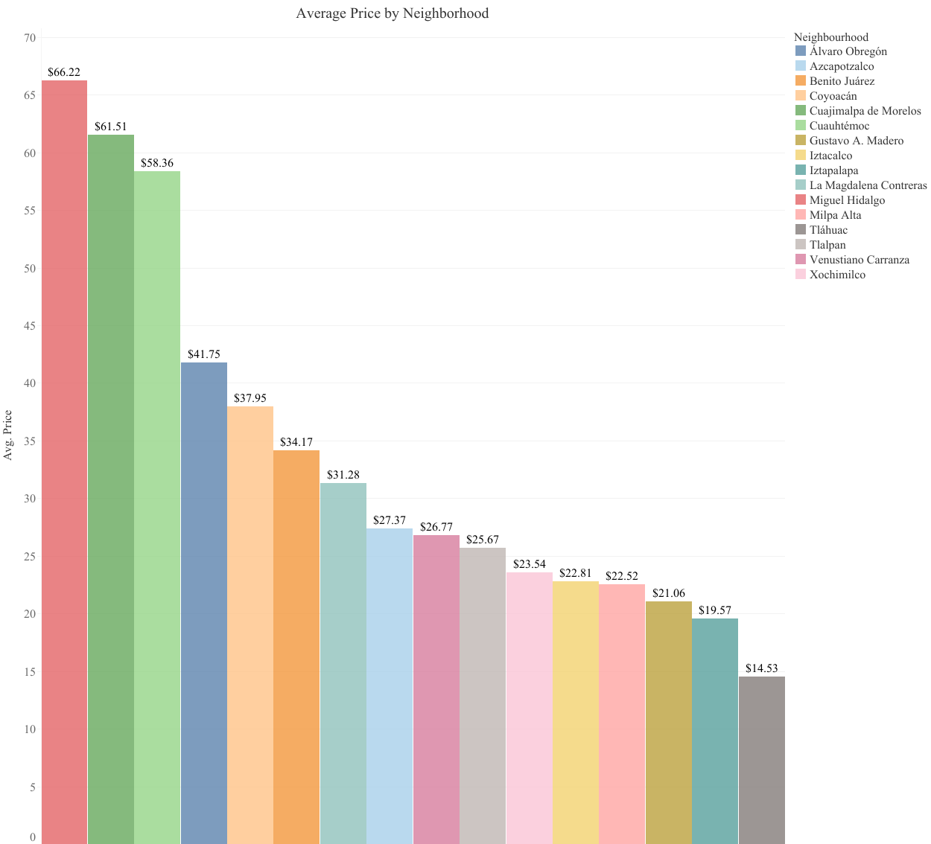
CDMX
There are a total of 16 ‘Boroughs’ or Colonias as they’re called in CDMX.
The top 3 Colonias by Average unit prices are Miguel Hidalgo, Cuahimalpa de Morelos, and Cuauhtemoc.
Cuauhtemoc houses the Plaza de Zocalo, the center of CDMX and it’s politics.
The Miguel Hidalgo Colonia houses the most expensive neighborhood in the entire country, Polanco.
Notes:
There are a total of 16 borough’s or Colonias as they’re called in CDMX. The top 3 Colonias by average unit prices are Miguel Hidalgo, Cuahimalpa de Morelos and Cuauhtemoc.
Cuauhtemoc houses the Plaza de Zocalo, the center of CDMX and it’s politics.
The Miguel Hidalgo Colonia houses the most expensive neighborhood in the entire country, Polanco.

Slide 3
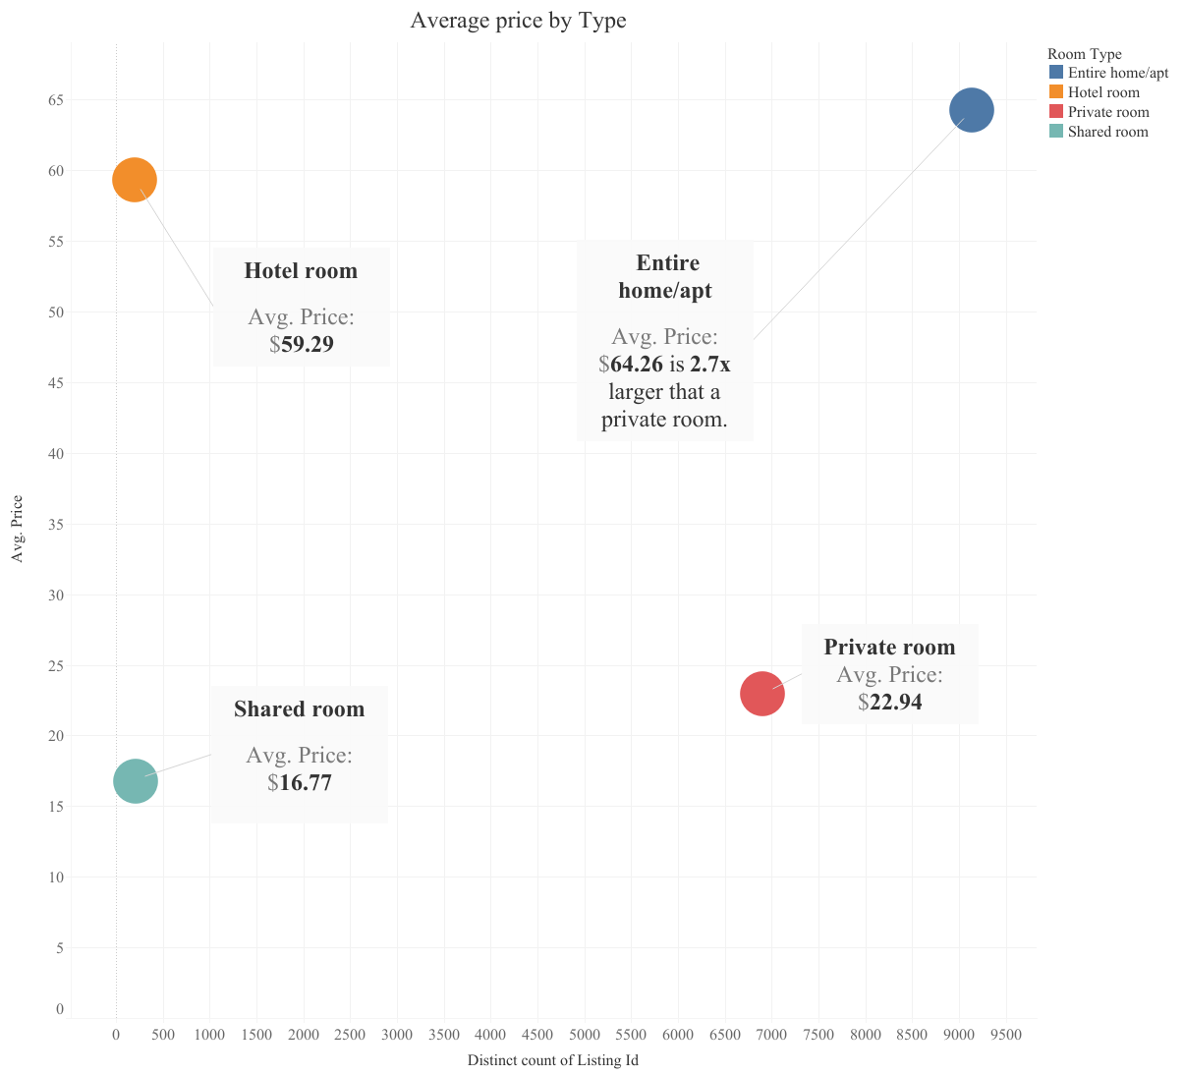
CDMX
Entire Home/Apt is the most viable option for maximizing revenue. Hotel Rooms are a close second
Hotels in CDMX take a cut of your profits on top of Airbnb’s and they can price control to keep consistent with their own prices.
All of a hotel’s amenities can be found in luxury residential buildings
Also to consider....
Cleaning services are fixed as you must use a third party. A clean apartment is expected across the board by check-in.
Notes:
For Airbnb, you can offer 4 different unit types, an entire home/apt, a private room, a hotel room or a shared room. Here we can see the average price against the number of units on the X axis. Starting clockwise, I want to cross out a shared room as a viable option, the average price is too low and there’s not a lot of listings offered. A hotel room can be a good option as it offers many amenities but that can be overshadowed by a luxury residential apartment. Something to consider, hotels in CDMX take a cut of your profits on top of Airbnb and can price control you to be within their prices. An entire apartment/home has an average price with $64.26 at 2.7x the price of a private room. For a private room to be financially viable you’d need at least a 3 bedroom apartment. Also, to consider… a clean unit at check-in is expected across the board and would have an increased cost per instance of cleaning.

Slide 4
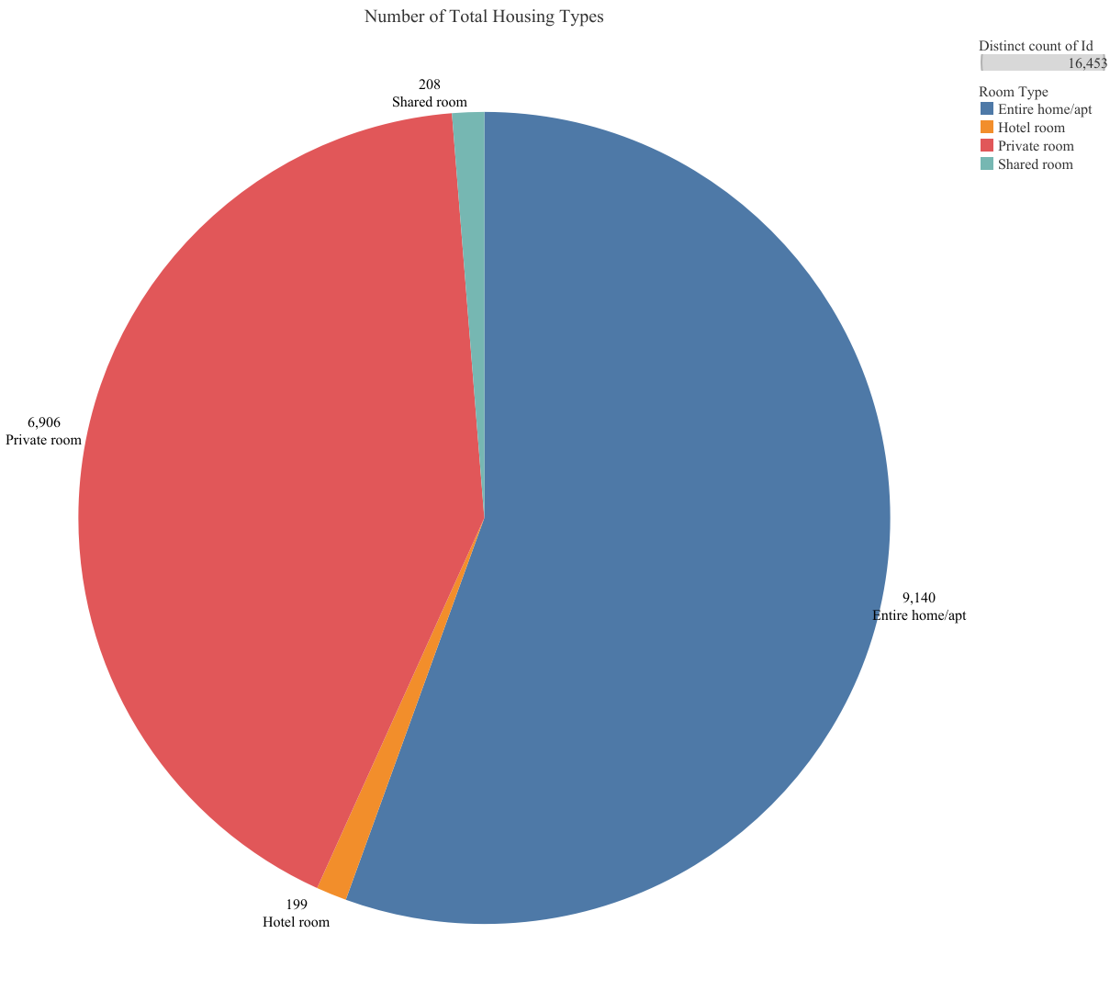
CDMX
There are a total of 16,453 unique Airbnb listings being offered in CDMX.
Entire home or apartment listings are the most popular for users followed by private rooms.
Shared rooms and hotel rooms only take a very small fraction of the pool.
Note …
While these numbers may indicate demand, it also likely tells a story of what units are financially viable as an Airbnb investment
Notes:
Taking a closer look at that x-axis from the previous graph… There’s a total of 16 thousand and a half units being offered in CDMX with entire homes and apartments taking up more than half followed by private rooms. Combined they dwarf shared rooms and hotel rooms. Also to note: while these numbers may indicate demand, it also liekly tells a story of what units are financially viable as an Airbnb investment. I personally think you should focus on renting out entire homes or apartments especially since we’ll be managing these units remotely. There’s less

Slide 5
CDMX
A Quick Look at Prices.
Polanco(Miguel Hidalgo) - The most expensive Colonia in the entire country at $73,000 MXN or $3258 USD per square meter. A 1000 sqft(92 square meter) home would cost $300k USD on average.
Cuáhtemoc, Alvaro Obregón, Benito Juárez - $33,000 MXN or $1472 USD per sq meter. A 1000 sqft(92 square meter) home costs $135,424. On average. Only a 10-20 minute drive from Miguel hidalgo.
It would only take 6 years of full bookings in the latter Colonias to make back your investment, not to mention appreciation.
Notes:
To take a quick look at housing prices, in our highest paying neighborhood a 1ksqft home costs close to a million usd on average. With the rest at only a few less dollars a day for airbnb, has real estate at less than half as much. These are average prices so you could get even cheaper real estate! I’ve seen prices as low as $9000 pesos which comes out to 16k usd for a 1000 square foot home. It would only take 6 years of full bookings in the latter Colonias to make back your investment.

Slide 6
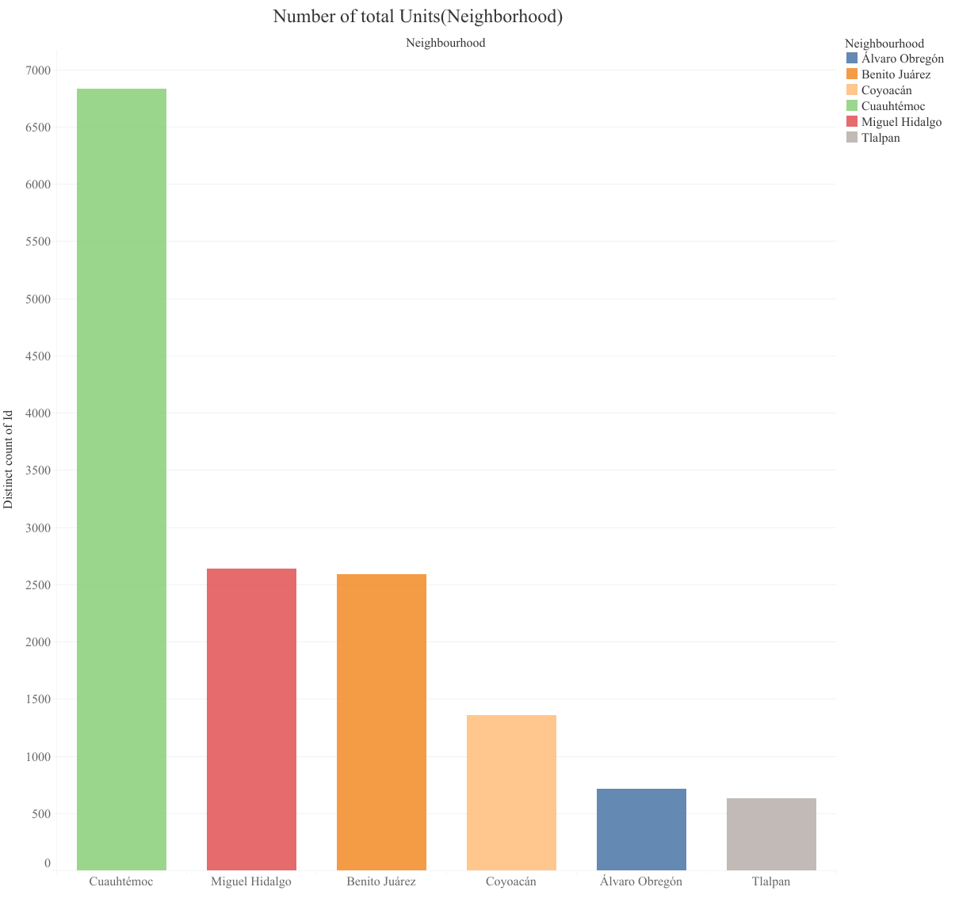
CDMX
The top 5 cities in terms of total Listings are Cuahtemoc, Miguel Hidalgo, Benito Juarez, Coyoacan, and Alvaro Obrego.
Cuauhtemoc has the most amount of listings, more than the next three neighborhoods combined, which is indicative of demand.
You should invest in Cuauhtemoc.
… Here’s more on why!
Notes:
So now, where should we buy our unit? Here are the total units offered in the top 5 neighborhoods with Cuauhtemoc having more listings than the next three Colonias combined. This is where the demand is and has cheaper real estate. You should invest here and here’s some extra reasons why.

Slide 7
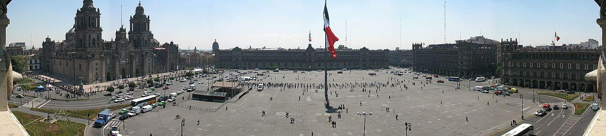

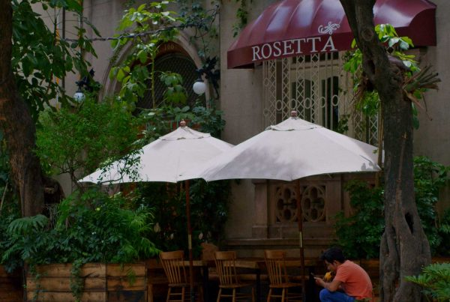
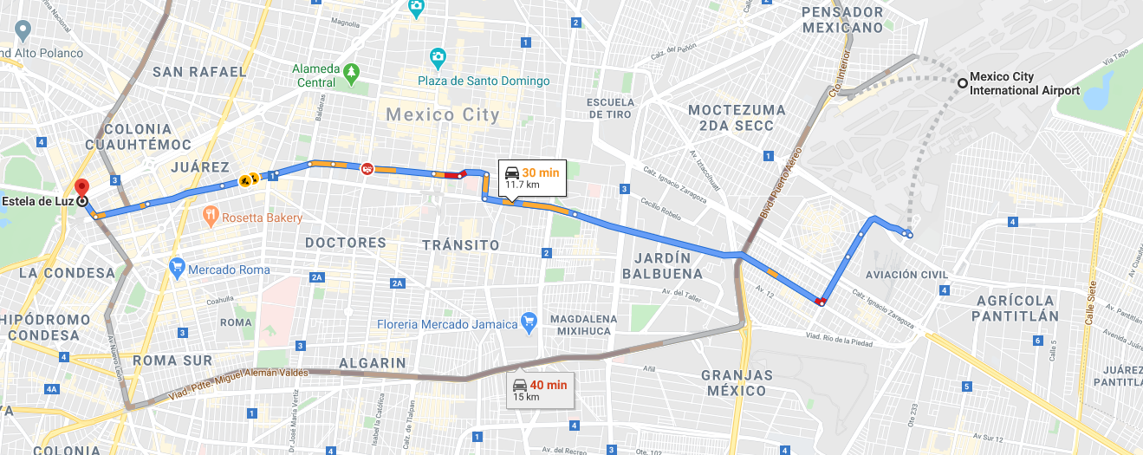
CDMX
Notes:
Not only is the Cuauhtemoc the home of Plaza de Zocalo as mentioned earlier. It also houses neighborhoods such as La Roma, a neighborhood recently premiered in the award winning film “Roma” that has amazing cinemetagraphy although a bit long, world renowned michellin starred restaurants such as Rosetta in La Condesa. These two neighborhoods are akin to popular lower Manhattan destinations such as the two villages and Soho. Very culturally significant with an abundance of city amenities.
Also, it’s western most point is only a 20-30 minute uber ride for only 200-300 pesos or $8-$12 USD which is nothing for an international traveler.

Slide 8
CDMX
Takeaways & Next Steps
Even though Cuauhtemoc is only 3rd in average price, it is the highest in demand with the highest revenue potential. It also includes city amenities such as the Plaza de Zocalo and culturally significant neighborhoods such as La Condesa and La Roma.
Entire home or apartment rentals are highest in demand and the most populous units offered amongst Airbnb hosts.
Hotel rooms are the second most viable option with all the amenities offered but can be replaced with luxury buildings.
Time in between bookings makes shared rooms and single rooms a much more volatile revenue stream.
Cost of cleaning rooms between AirBnB tenants is a fixed price and causes single or shared room offerings to be less financially viable
What are the real estate prices in Cuauhtemoc? Even with the high demand, do prices say you should try other top Colonias such as Miguel Hidalgo or Benito Juarez?
What in-home amenities to Airbnb users look for the most?
Notes:
We know that even though Cuauhtemoc is only 3rd in average price, It’s the highest in demand with the highest revnue potential and HALF the real estate prices than the Colonia, Miguel Hidalgo, with the highest average prices. Considering everything, I’ll reiterate that entire home or apartment rentals are our best bet considering our remote model. Moving forward, we need a deeper and clearer insight on real estate prices and also we need to know what types of in-home amenities are looking for the most.
Cuauhtemoc is central to all that is Mexico and your investment will appreciate. A single use home or apartment in Cuauhtemoc is the way to go.

Slide 9


Thank You!
Notes:
Thank you

